Slide 1
Module 4 Week 1- MongoDB

Slide 2
MongoDB Roadmap
Week 1
Introduction to Document databases
Understanding Document database model
HTML and JSON documents
JSON Primer
Working with Collections
Terminology
When to use/not to use document databases
Getting Started with MongoDB
What is MongoDB
MongoDB features
MongoDB Data Model
Datatypes, Database, Collections
MongoDB Atlas
Lab 1

Slide 3
Introduction to Document Databases

Slide 4
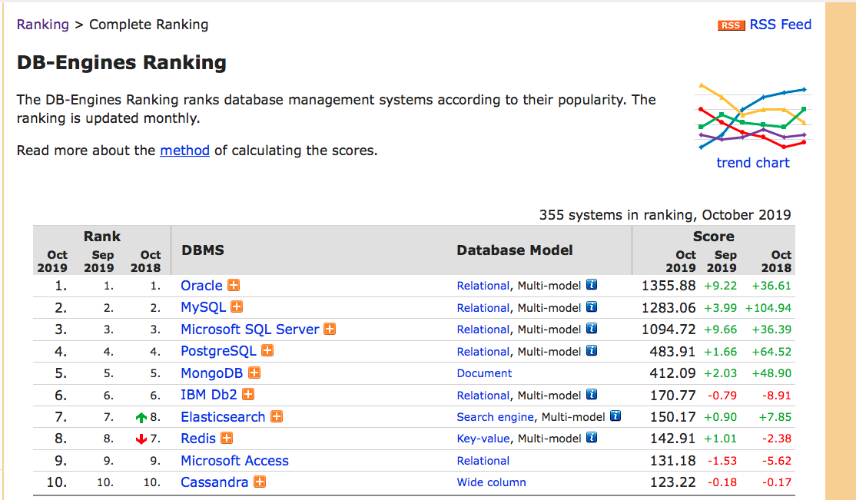
Introduction

Slide 5
Introduction
Document databases
No common structure for data
Similar to RDBMS in ability to query and filter collections of documents
Document databases are most popular (over 70 million downloads)
MongoDB is the most popular Document database
Document term that describes a set of key/value pair

Slide 6
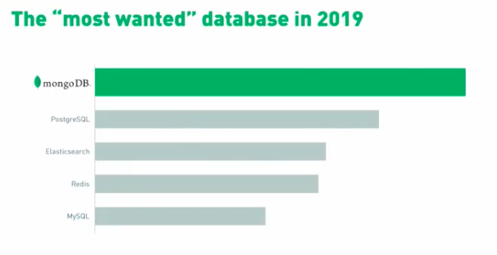
Introduction

Slide 7
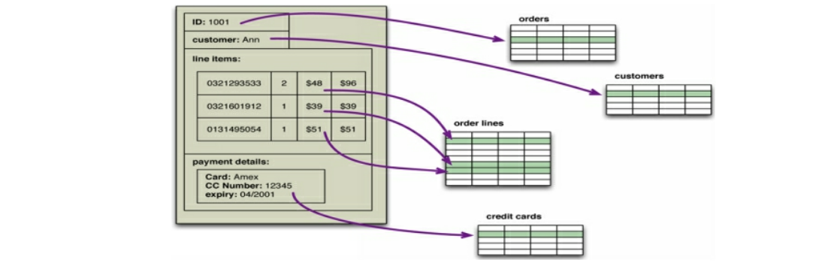
Introduction

Slide 8
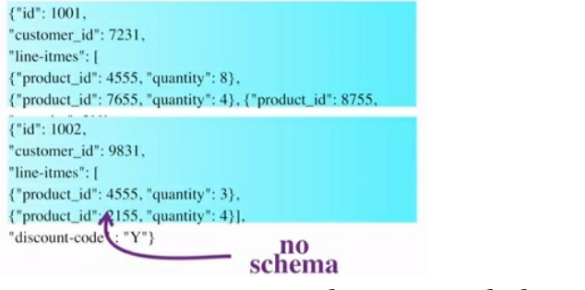
Document Data Model
Database stores and retrieves documents
Documents are self-describing, hierarchical tree data structures
Maps, collections, scalar values

Slide 9
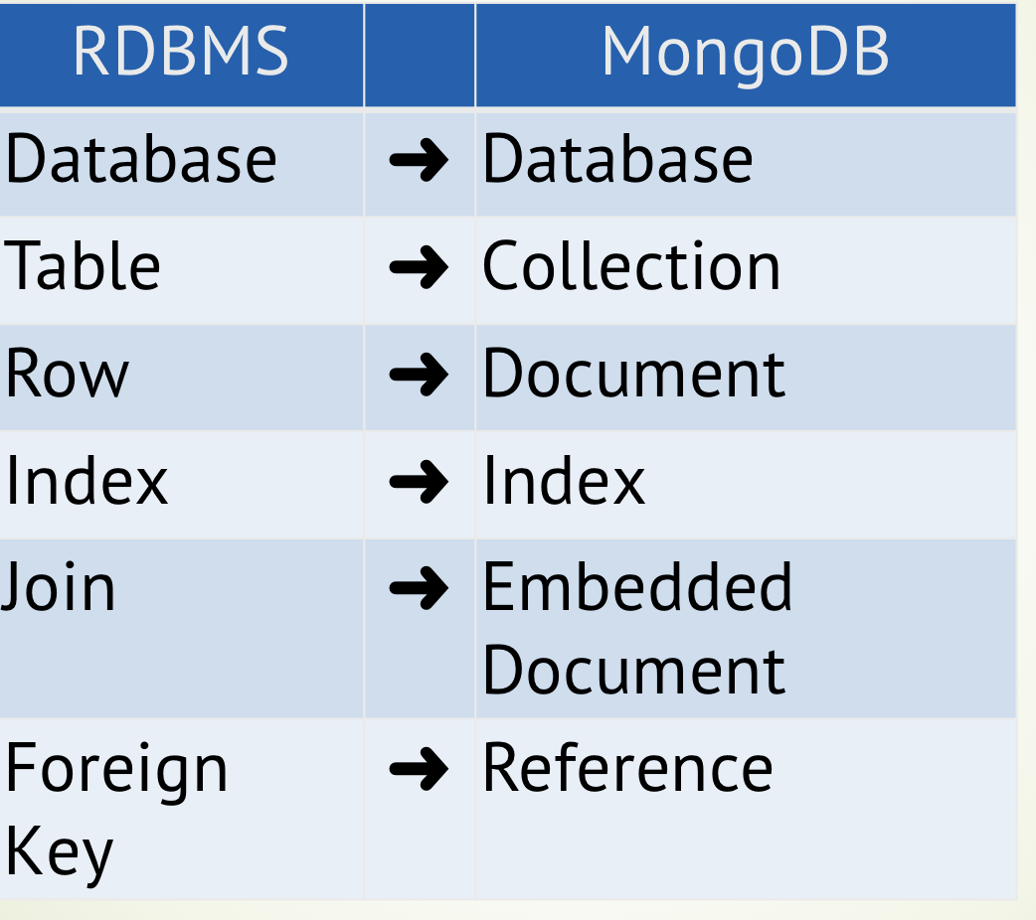
RDBMS vs Document Data Model

Slide 10
RDBMS vs Document Data Model

Slide 11
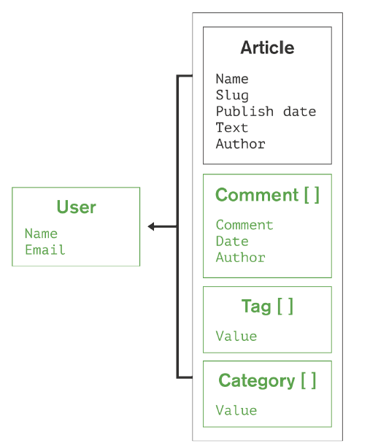
RDBMS vs Document Data Model

Slide 12
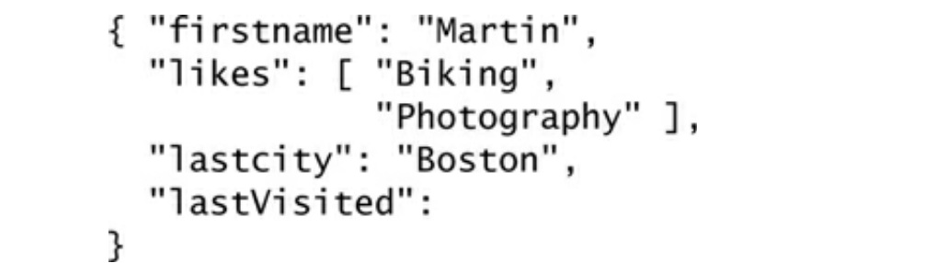
What is Document Database?

Slide 13
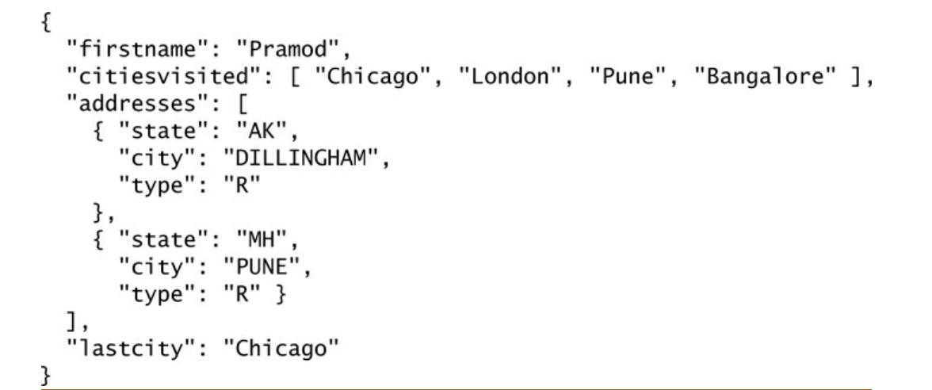
What is Document Database?

Slide 14
Document Data Model
Similar documents are stored together
Individual documents aren’t made of relationships
Store documents in the value part of the key-value store
Can create new attributes without need to define them
Document Validation – dynamic schemas

Slide 15
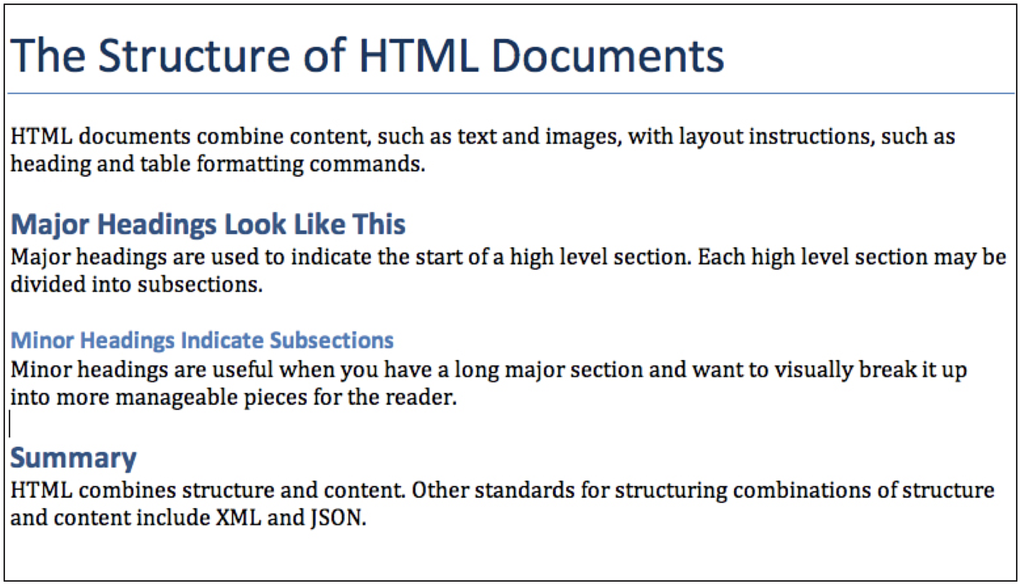

Slide 16

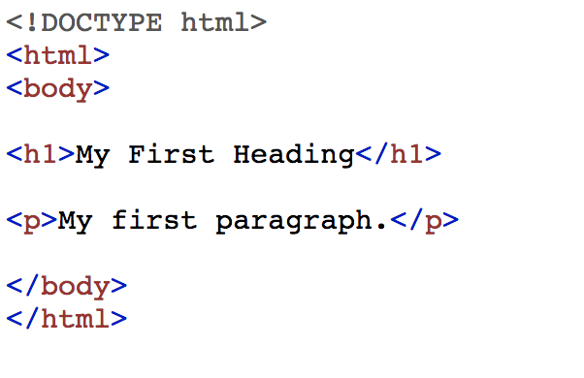
Sample HTML Code

Slide 17
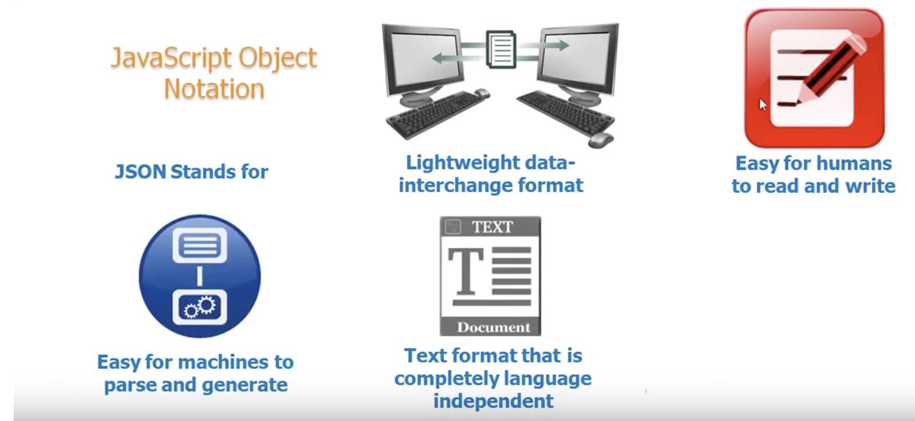
JSON
json.org

Slide 18
JSON Primer
Historically data was exchanged using CSV (simple-text format)
Separates row with new line and comma
Good to store flat data that doesn’t have repeating values
XML (eXtensible Markup Language)
Used for complex and highly structured data
Overkill for simple data exchange
JSON (eXtensible Markup Language)
Unlike XML makes content easy to understand and use

Slide 19
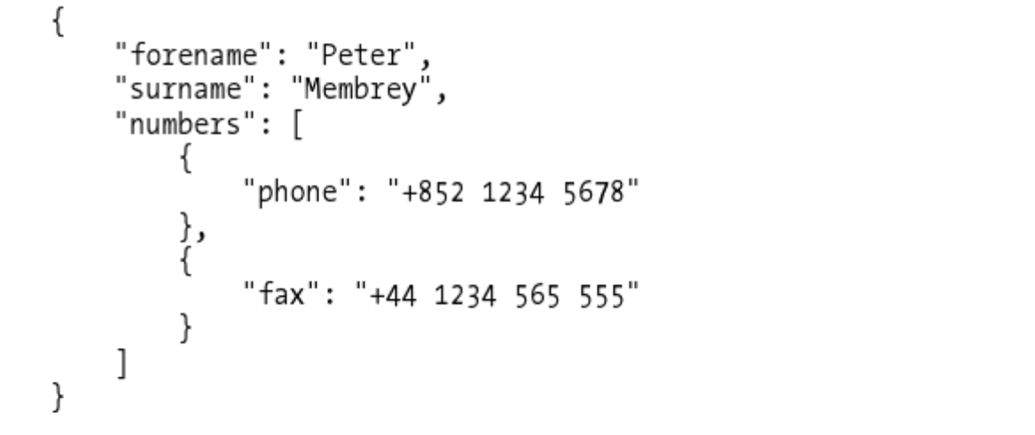
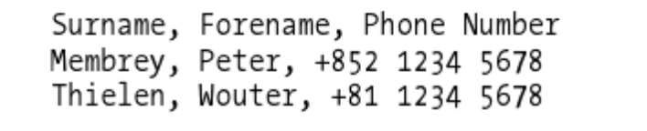
CSV vs JSON

Slide 20
MongoDB Query Model
MongoDB provides native drivers for all popular programming languages
Java, .NET, Ruby, PHP, JavaScript, Node.js, Python, Perl, Scala, etc
Fundamental difference between RDBMS and MongoDB
MongoDB query model is implemented as methods or functions within the API of a specific programming language like SQL

Slide 21
JSON vs RDBMS
 | Structure | Data Retrieval | Sorting | Metadata | Application
RDBMS | Data is stored in tables in form of columns and rows | SQL to fetch data | Use SQL to sort | Info is stored in schema on the type and structure of data | MySQL, Oracle, MS SQL, DB2
JSON | Use arrays and objects (can be nested recursively) | JSONiq or JAQL | Arrays can be sorted in JSON | Can use schema for the same, but it is not predefined | MongoDB, CouchDB

Slide 22
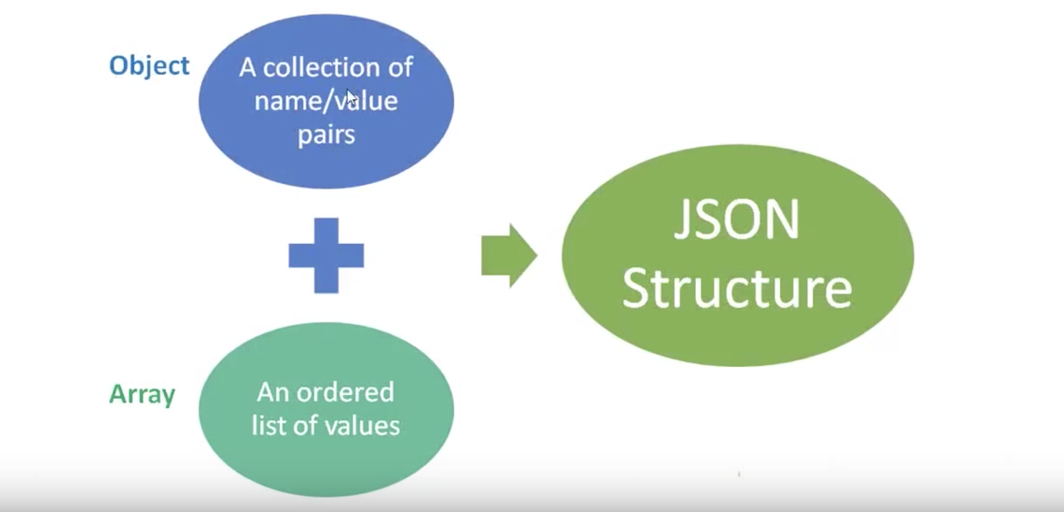
JSON Object/Array

Slide 23
JSON Object
JSON Object
Set of name/value pairs
Begins with { (left brace)
Ends with } (right brace)
Each name is followed by : (colon)
Name/value pairs are separated by , (comma)
Names are always Strings

Slide 24
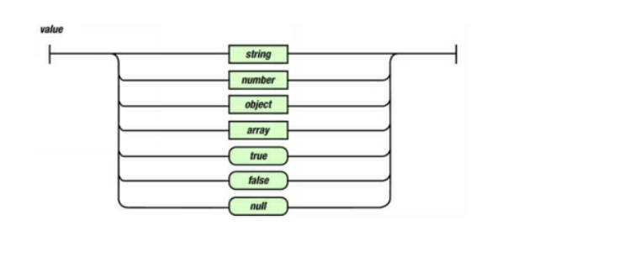
JSON Object Syntax

Slide 25
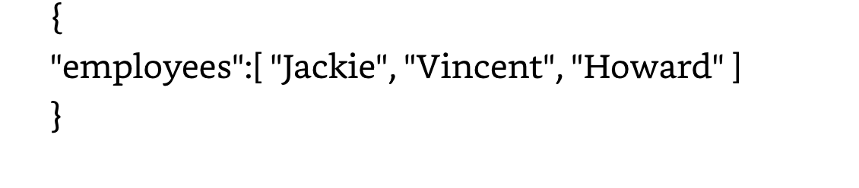
Arrays in JSON
Represent ordered list of values
Begins with [ (left bracket)
Ends with ] (right bracket)
Name/value pairs are separated by , (comma)

Slide 26
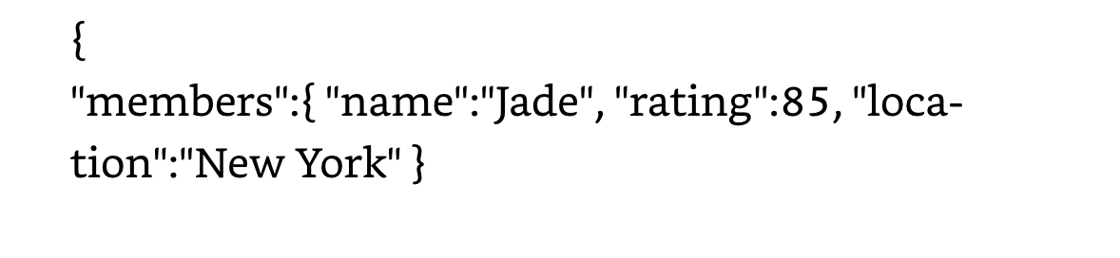
Objects in JSON
Represent unordered collection of name-value pairs
Begins with { (left brace)
Ends with } (right brace)
Key/value pairs are separated by , (comma)
Used when key names have arbitrary strings

Slide 27
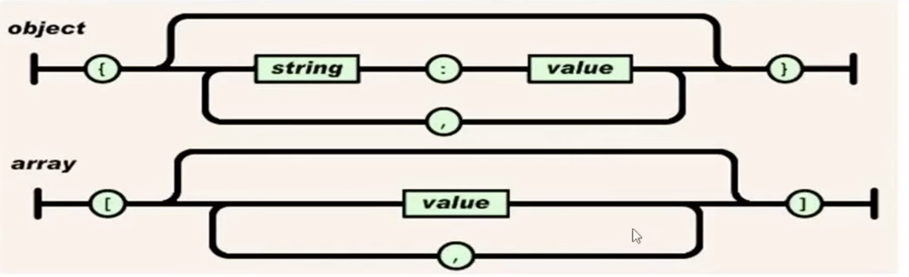
JSON Object/Array Syntax

Slide 28

JSON Key
JSON key (name) must be a string inside double quotes (unlike JavaScript)
The value can be a string, number, array, Boolean, null or JSON object
Name always has to a string (unlike JavaScript)

Slide 29
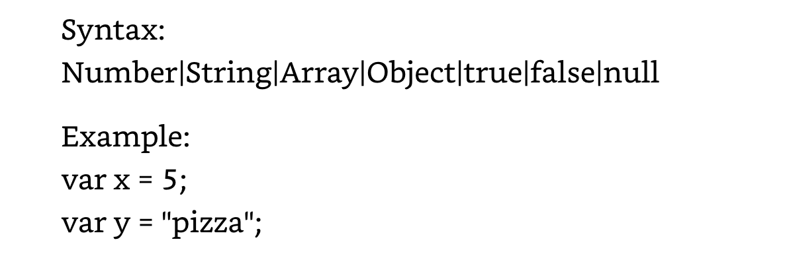
JSON Value
Values include string, number, Boolean, object, array or null

Slide 30
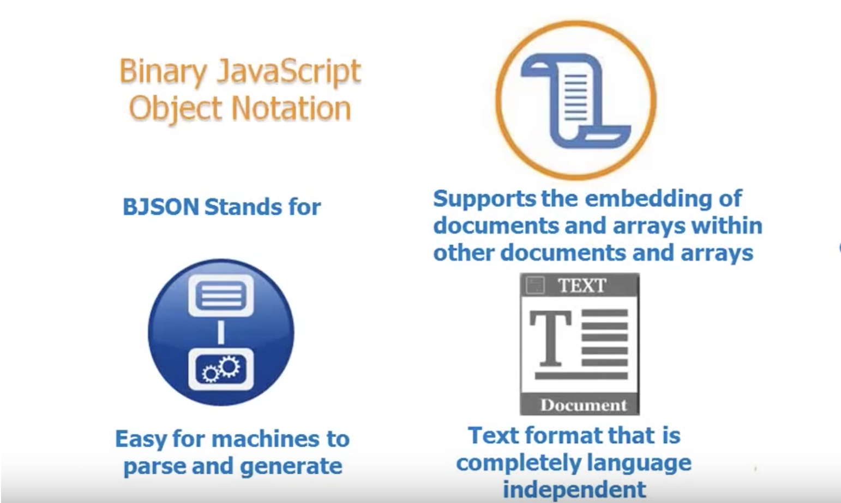
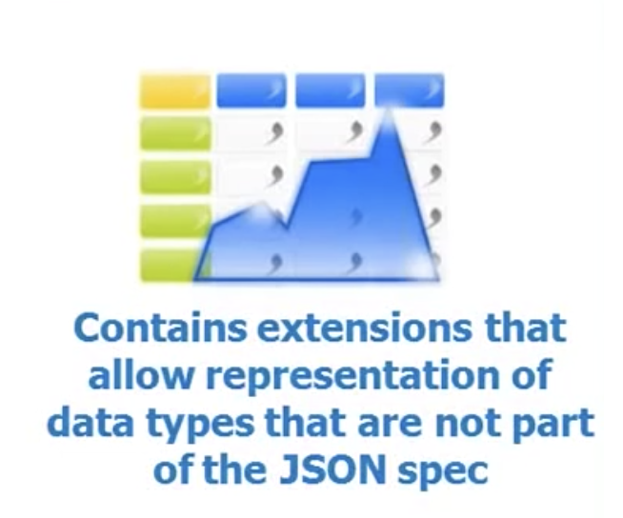
BSON
http://bsonspec.org

Slide 31
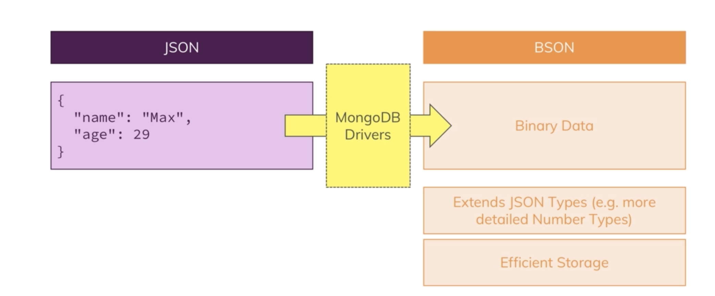
BSON
http://bsonspec.org

Slide 32
Database, Collection and Document
Database – physical container for collections
Collection – group of MongoDB documents
Document – set of key-value pairs

Slide 33
Working with Collections
Documents are grouped in collections of similar documents
List of documents
Modeling document databases = decide how to organize documents into collections
Can add, remove, update and search documents
As document collection grows – can add more servers to your cluster
Documents in same collections don’t need to have identical structure, but it should be common

Slide 34
Terminology - Document
Document: group of ordered key-value pairs.
In some cases, order of key-value pairs matters in determining identify of document
Same values in different orders would be different documents
Keys are strings and values can be different datatypes
Easier to implement common requirements (less code)
Example: Customer documents

Slide 35
Terminology - Collections
Collection
A group of documents, frequently with similar structures
Usually related to the same entity
Enable developers to efficiently operate on groups of related documents
Support additional data structures, such as indexes, that make operations more efficient

Slide 36
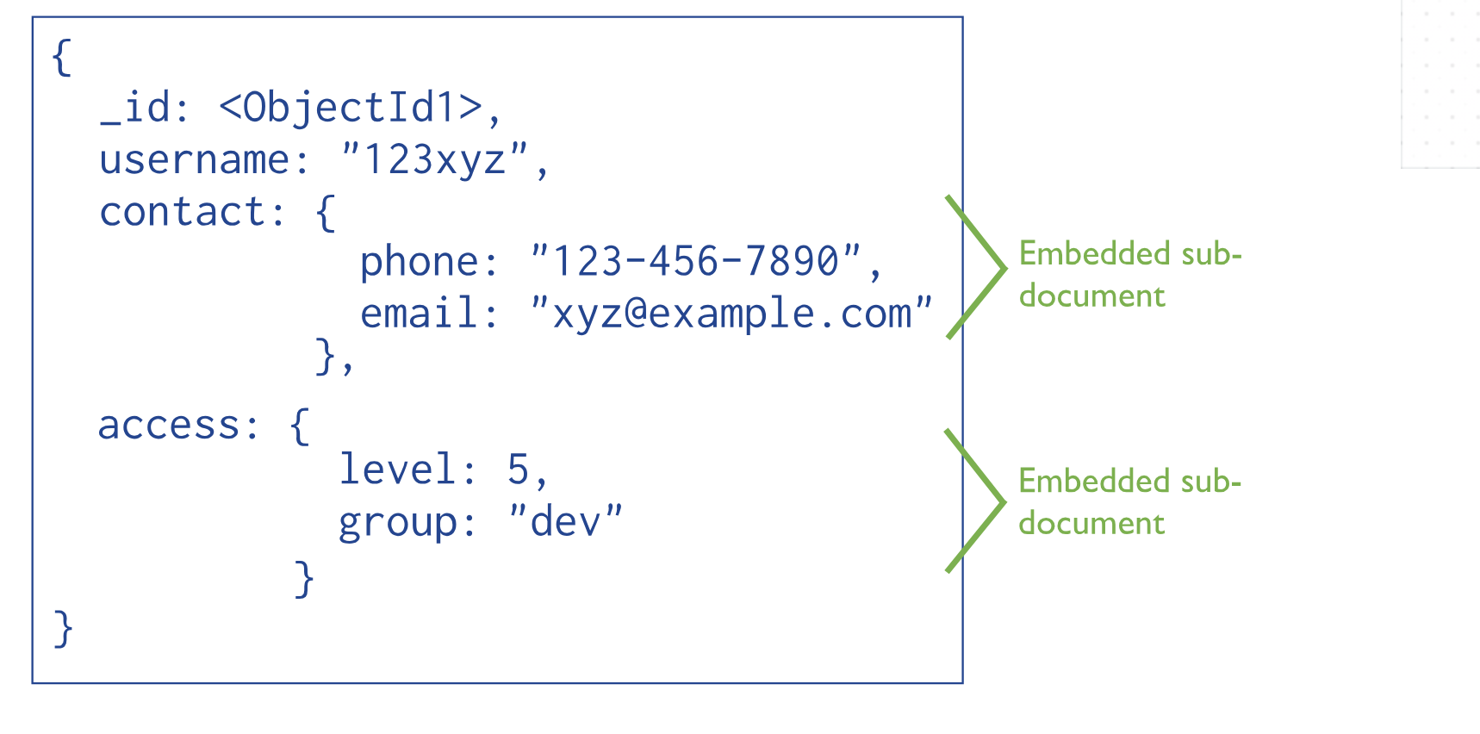
Terminology – Embedded Document

Slide 37
Terminology – Schema Design
Yes, there is no schema, but
Document database is schema-less
Can still have some schema!
You need to decide how to store your information
How do design embedded documents
Decide how data fits together

Slide 38
When to Use Document Databases
When to Use
Data schema changes frequently
Application will often need data in a computed or aggregated form
Can create pagination of query results efficiently
Use Cases
Event Logging
Content Management Systems, Blogging Platforms
Web Analytics or Real-Time Analytics
E-Commerce Applications

Slide 39
When Not To Use Document Databases
“Non”- Use Cases
Complex transactions spanning different operations
Queries against varying aggregate structure

Slide 40
Getting Started With MongoDB
https://docs.mongodb.com/manual/tutorial/getting-started/

Slide 41
What is MongoDB
Open-source, document-oriented and cross-platform database
Developed by 10gen
Founded in 2007
Leading NoSQL database
Written in C++
Supports APIs (drivers) in many computer languages
JavaScript, Python, Ruby, Perl, Java, C++
Provides high performance, high availability and scalability
Uses JSON-like documents with schema
BSON

Slide 42
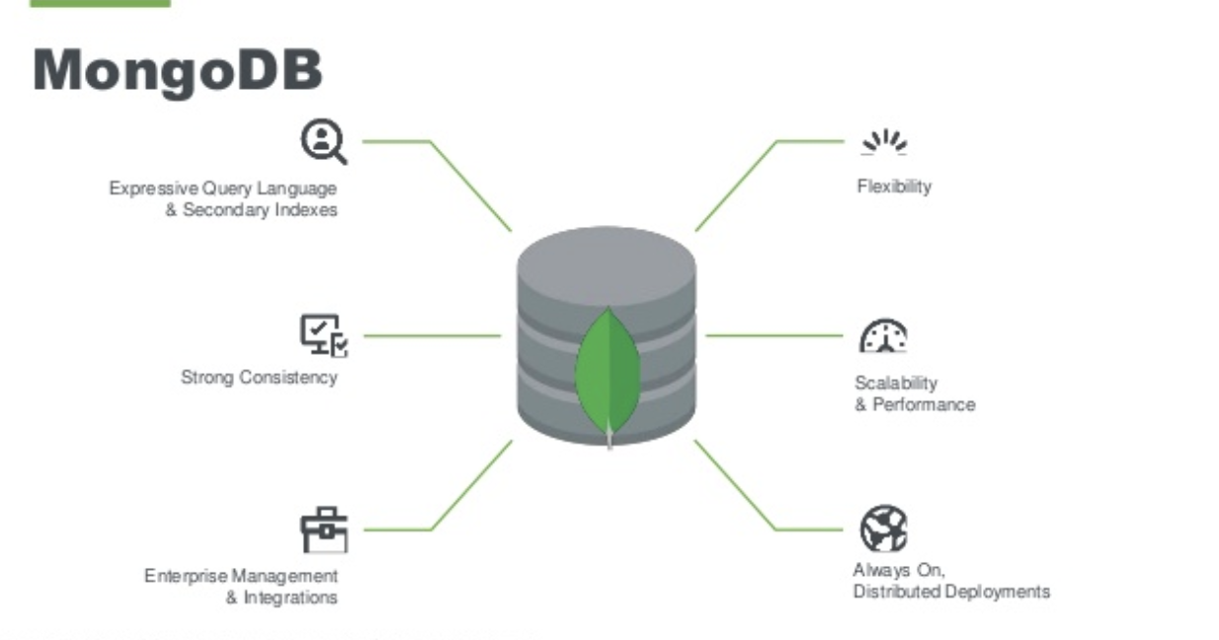
What is MongoDB

Slide 43
Key Concepts Behind MongoDB
One size does not fit all
Documents instead of rows
Fast
Scalable
There should always be more than one copy of the database
If single database fails, restore from other server
Each MongoDB instance has multiple databases
Each database has multiple collections

Slide 44
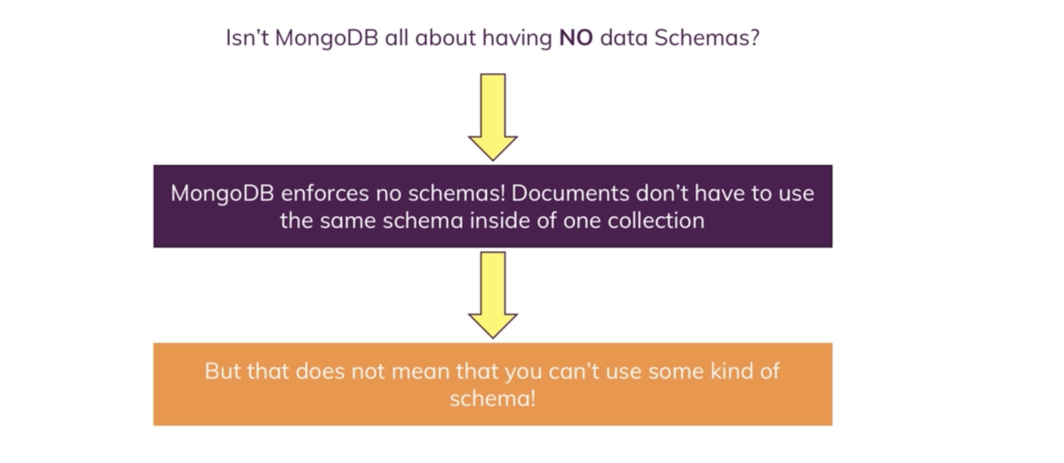
Is MongoDB Schema-less or Not?

Slide 45
MongoDB Features
Rich Query Support
Can query database like we do SQL databases
Large query set supports Insert, Update, Delete and Select operations
Support fields, range queries, regular expressions
Queries support projection – return value for specific keys
Query language expressed via JSON and has constructs:
$query for the where clause
$orderby for sorting the data
$explain to show the execution plan of query

Slide 46
MongoDB Features
Indexing
Special data structures that store a small portion of the collection’s data set in an easy to traverse form
Indexes are references to documents ordered by key
All documents are automatically indexed on the _id
Special case and cannot delete this index
Uniquely identifies each document
Allows fast lookup
Can create your own indexes
Can create indexes on embedded documents
Can create composite indexes

Slide 47
MongoDB Features
Replication
Provide more than one copy of data
Multiple copies of data with multiple servers
Provides fault tolerance
One database goes down, the application uses other database servers
Replica sets
Master-slave replication
Chose strong or delayed consistency
Geospatial features

Slide 48
MongoDB Features
Load Balancing
Replica sets provide multiple copies of data
MongoDB can scale read operation by client request directly to secondary node
This divides nodes across multiple servers

Slide 49
MongoDB Features
File Storage
We can store documents up to 6MB directly to the MongoDB JSON field
For documents > 16 MB, MongoDB provides GridFS to store in chunks
GridFS is specification for storing and retrieving files > 16 MB
Kind of a file system to store files but its data is stored within MongoDB collections
GridFS divides files into chunks and stores in collections

Slide 50
MongoDB Features
Aggregation
Operations that process data records and return computed results
MongoDB provides aggregation operations
Running data aggregation on MongoDB instance simplifies application code and limits resource requirements
MongoDB provides data pipeline to move large data to the aggregate function that improves performance

Slide 51
MongoDB Features
Map-Reduce Functionality
Performs complex aggregator functions given a collection of keys, value pairs
Data processing paradigm for condensing large volumes of data into useful aggregated results
MongoDB provides mapReduce database command

Slide 52
MongoDB Data Model
Document based (maximum 16 MB)
Documents are in BSON format (field-value pairs)
Each document stored in a collection
Collections
Have index set in common
Like tables in RDBMS
Documents do not have to have uniform structure

Slide 53
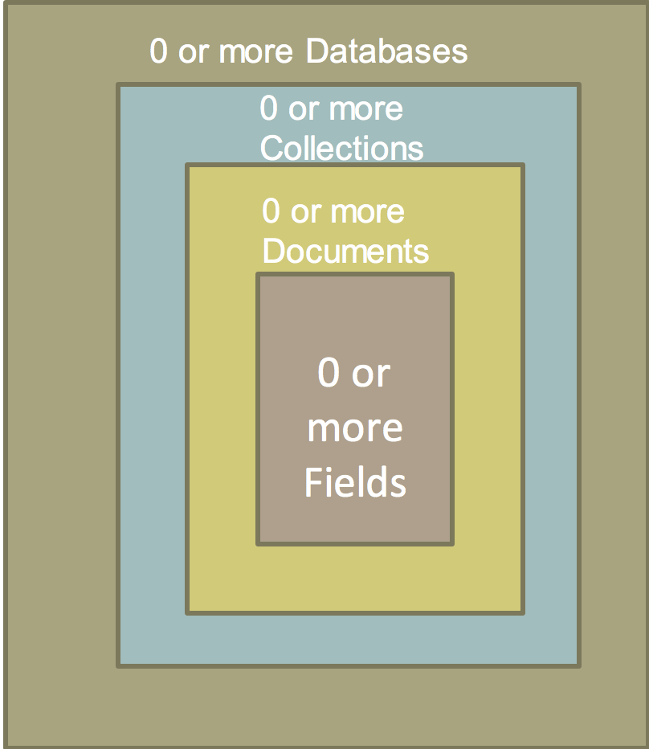
MongoDB Data Model
MongoDB instance may have zero or more ‘databases’
A database may have zero or more collections
A collection may have zero or more documents
A document may have one more fields
MongoDB indexes function much like RDBMS indexes

Slide 54
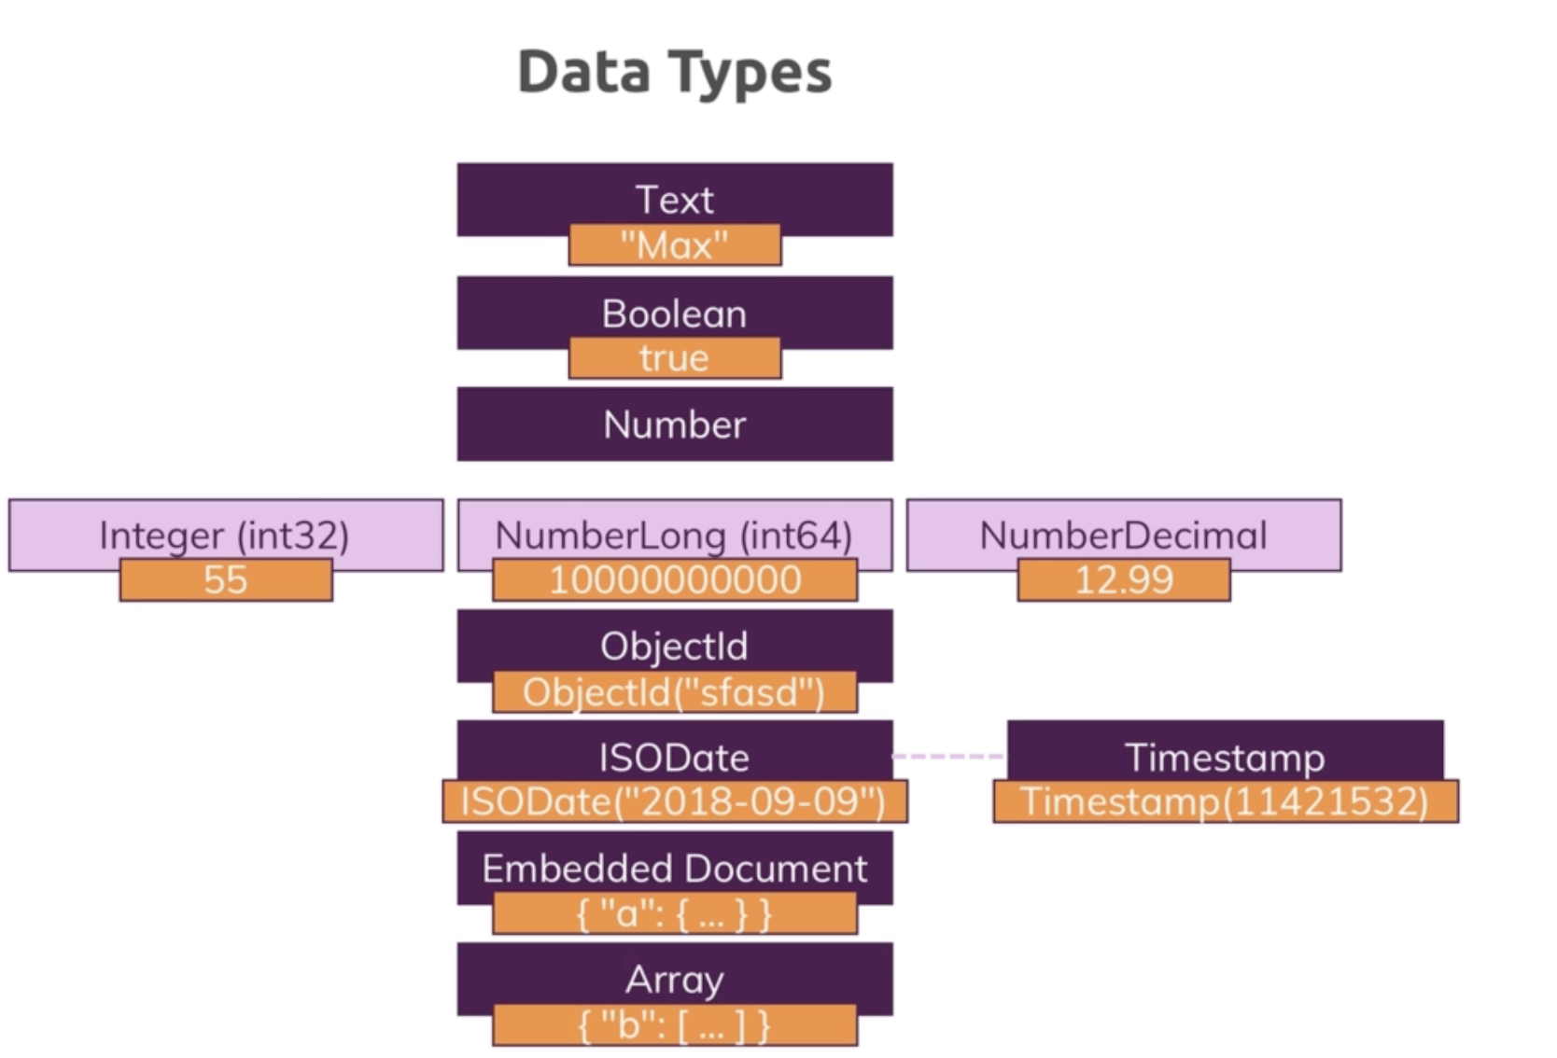
MongoDB Data Types

Slide 55
MongoDB Data Types
Supports data types:
Array – A set or list of values. Multiple JSON objects represent array of elements. Array of city values:
{
“cities” : [“London”, “Delhi”, “New York”]
}

Slide 56
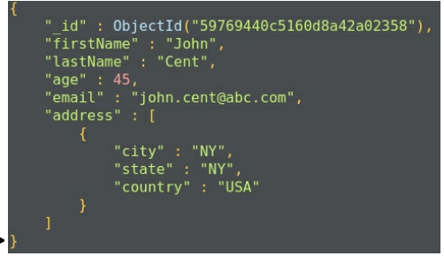
MongoDB Data Types
Supports data types:
Embedded document: document-like structure that can be used as a key

Slide 57
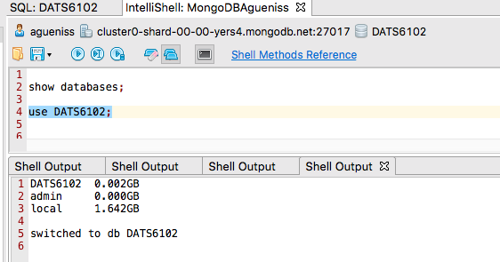
MongoDB Datatabase
Data is stored in form of collections. → database is a group of collections

Slide 58
Using MongoDB Shell
To check which database you are using
DB
To show all databases
SHOW DBS
To switch database or make a new one
USE <NAME>
To see which collections exist
SHOW COLLECTIONS

Slide 59
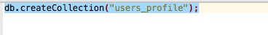
MongoDB Collections
Collection is a group of documents
Container for MongoDB documents
Equivalent to SQL tables
Collection should only store related documents
To create new collection

Slide 60
MongoDB Collections
Documents in a collection should have related purpose
Database cannot have collections with the same name
Collections are schema-less
Do not force the user to define schema
Documents within collections have different fields
One document in a collection might have address field and the other might not have it
Collections can have sub-collections
Blog.posts

Slide 61
MongoDB Documents
Data is stored in a form of documents
Document is a collection of key-value pairs
Key is known as attribute
Documents cannot contain duplicate keys

Slide 62

MongoDB Documents
MongoDB documents have a special field called _id._id
12-byte hexadecimal number that ensures uniqueness of the document
Generated by MongoDB automatically
Represents Primary Key for MongoDB documents

Slide 63
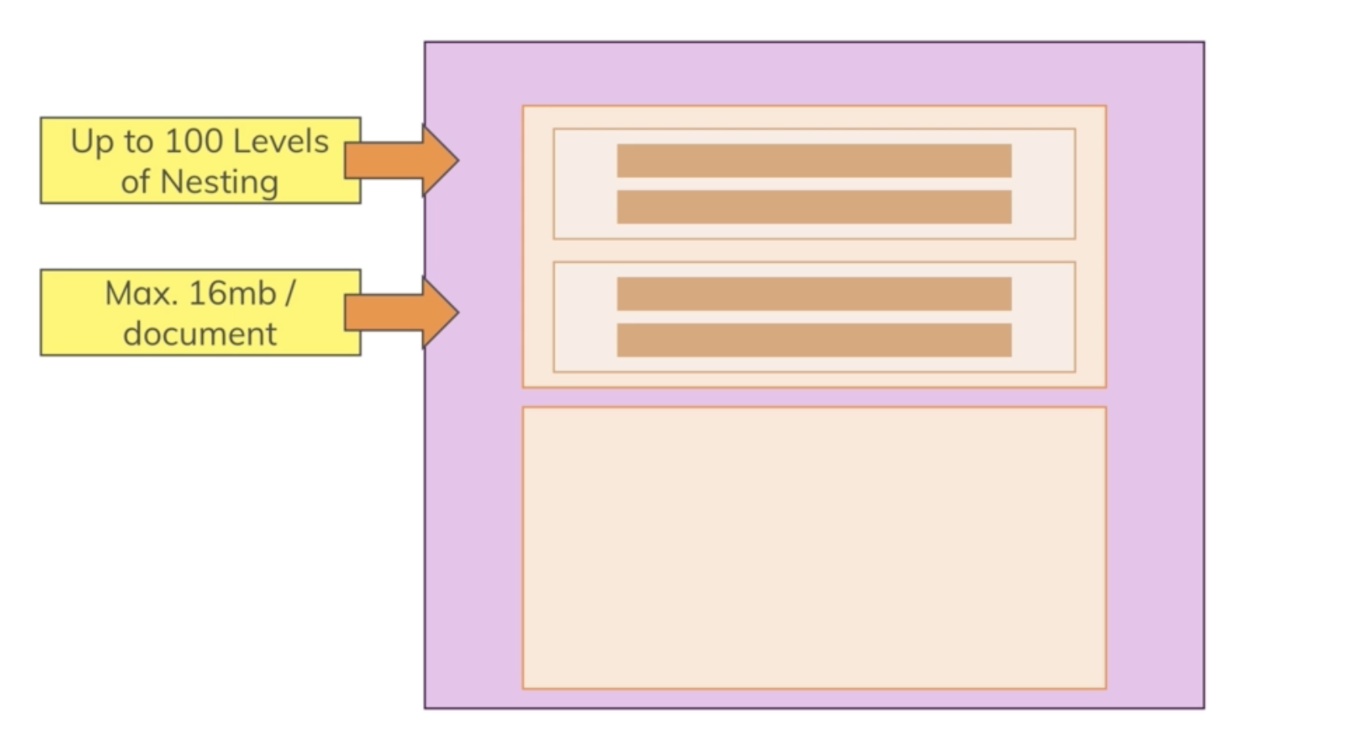
MongoDB Embedded Documents

Slide 64
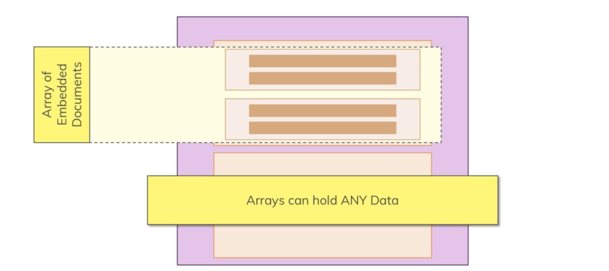
MongoDB Arrays

Slide 65
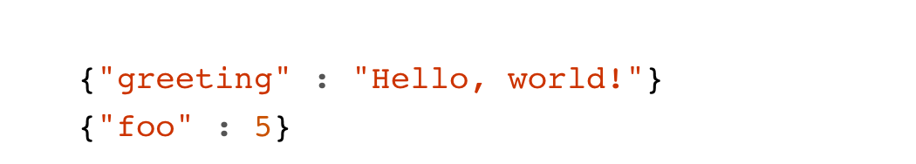
Dynamic Schemas
Collections have dynamic schemas
Documents within single collection can have any number of different “shapes”
Both of these documents can be stored in single collection:

Slide 66
MongoDB vs MySQL
MYSQL | MongoDB
DATABASE | DATABASE
TABLE | COLLECTION
ROW | DOCUMENT
COLUMN | FIELD

Slide 67
MongoDB Advantages over RDBMS
Collections are schema-less
Structure of a single document is simple and clear
No complex joins
MongoDB has rich query support – dynamic queries
MongoDB is easy to scale
Conversion/mapping between application and database objects

Slide 68
MongoDB Limitations
Maximum document size supported by MongoDB is 16 MB
Maximum document nesting level is 100
Maximum namespace (database + collection name) is 123 characters
If we apply an index to any field, that field value cannot contain > 1024 bytes
You cannot rollback automatically if data is more than 300 MB.
Need manual intervention in these cases

Slide 69
MongoDB Atlas
Database as a Service for MongoDB
Scalable back-end
Available on AWS, GCP, Azure
Highly available, even when scaling
Patch maintenance/Backup/Metrics/Alerts
Your own MongoDB cluster in a cloud
MongoMirror
Offers data explorer
Visually explore data and run queries
View information about indexes

Slide 70
Studio 3T for MongoDB
IDE for MongoDB
Helps us manage MongoDB
Windows, Linux, Mac
Rich query capability
IntelliShell – full blown mongo shell
Use SQL to query MongoDB
We will do free trial in this class

Slide 71
How to Query MongoDB With Studio 3T
With SQL
Mongo Shell
Aggregation Editor
Visual Query Builder

Slide 72
MongoDB LAB 1

Slide 73
Sources
“NoSQL Distilled: A Brief Guide to Emerging World of Polyglot Persistance”
“NoSQL For Mere Mortals”
“Json for Beginners”
“Definite Guide to MongoDB: A Complete Guide to Dealing with Big Data Using MongoDB”

